Slide 2
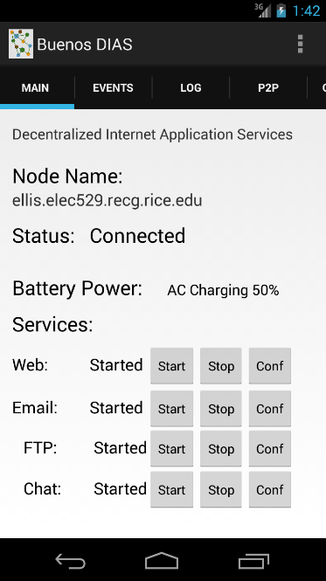
Event and Debug Logs and Configuration Tabs
Configurable Node Name
Connection and Overall Status Monitoring Thread/Event Receiver
Battery Power Monitoring Thread and Event Broadcast Receiver
Can act on power changes.
Pluggable Services List
Services can provide Start, Stop, and Configuration methods.
Web, Email, FTP, etc.

Slide 3
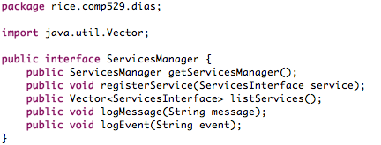
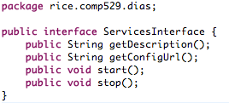



Web
Email
Other Services

Slide 4
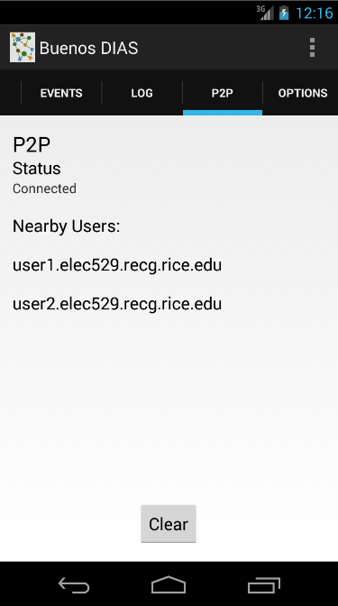
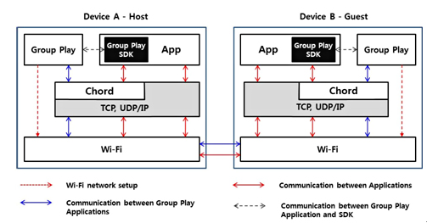
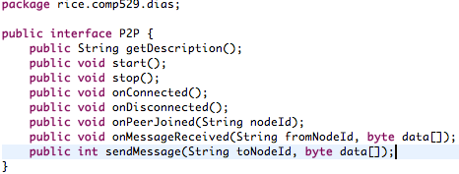
Samsung Group Play SDK Utilizes Chord
However, it is closed source and doesn’t execute outside of Android SDK. Chord SDK Discontinued
Facade
P2P Interface
Chord
Pastry
…

Slide 5
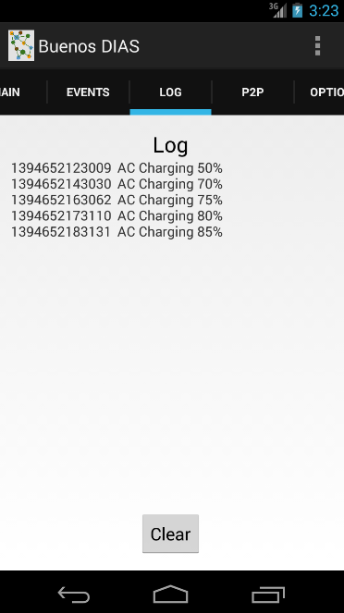
Event Log for asynchronous events received from the device such as, network and battery levels. It also logs events for pluggable services and building blocks.
Debug Log contains debug messages from monitoring threads and services.
Android application can react to changes in the battery level or network events.
It has monitoring threads for battery and network connections, and depending on thresholds, the application will be able to react and shutdown services or send notification messages.

Slide 6
Galaxy S4 Running DIAS
Dynamic DNS -> Local WiFi
ellis.route404.com
i-jetty, kirium, dyn-dns client
Web server sent over WiFi
2.35 GB Data / 2hrs
Can effectively monitor power levels with resource monitor threads. Can react to resource changes.

Slide 7
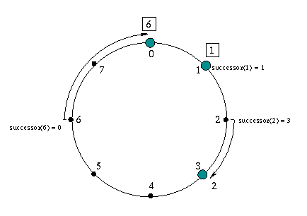



Related Work – Data Replication
Data replication in distributed systems, such as a Peer-To-Peer systems, where nodes are unreliable, additional considerations for the dynamic nature of nodes and data replication must be considered.
Decentralized P2P ﬁle sharing programs - replicate ﬁle data on end nodes, which may become corrupt or suffer from loss of availability
Limewire
Bittorrent
Kazaa
PAST
Built on Pastry
Replicates files close to owner’s nodes
Replicates entire files
CFS
Built on Chord – Coordinated File System
Replicates files close to owner’s nodes
Replicates at block level to distribute the load and storage space among servers in the network.
Plover - is a low-overhead ﬁle replication scheme for P2P networks that makes copies of ﬁles among physically close nodes based on capacities.
Content Delivery Networks
Replicate data near consumers.
Akami
Amazon S3

Slide 8
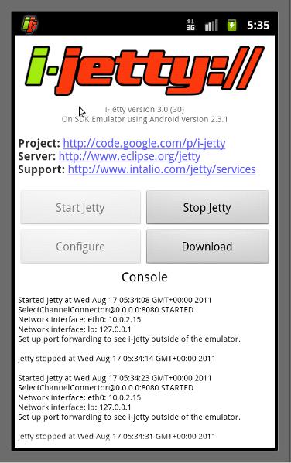
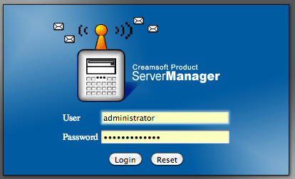
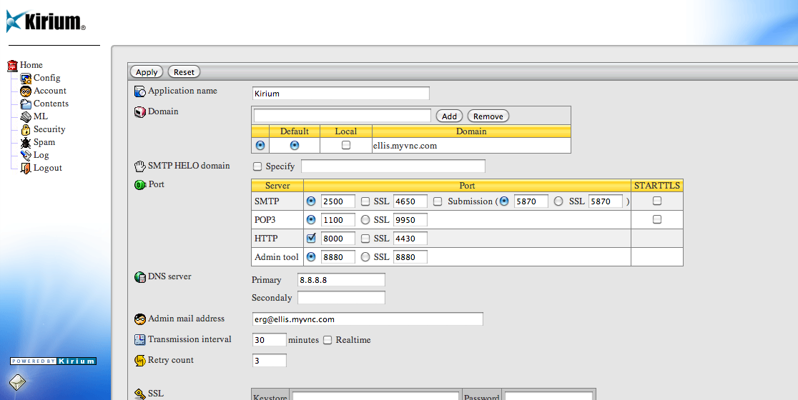
Backup

